Slide 1
Linear Regression Cont.
2 September 2021

Slide 2
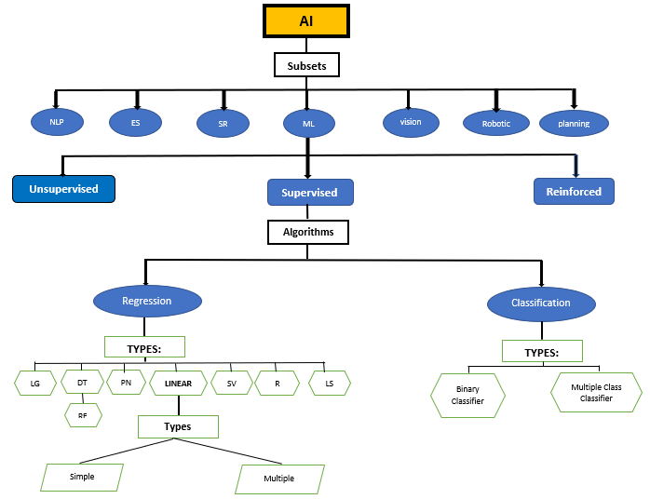
Overview

Slide 3
LINEAR REGRESSION
SIMPLE LR
SIMPLE LR
MULTIPLE LR
MULTIPLE LR
Describes the relationship between independent and dependant variable.
Estimates relationship between 2 or more independent variables and 1 dependant variables
Describes the relationship between independent and dependant variable.

Slide 4
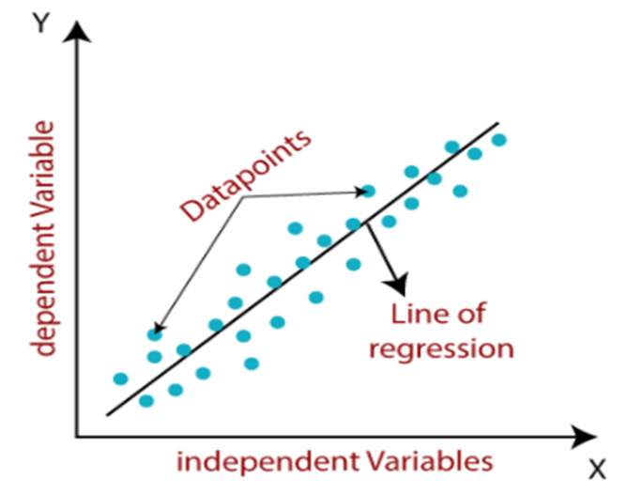

Linear Regression
Shows linear relationship between a dependent (y) and one or more independent (x) variables, hence called as linear regression.

Slide 5
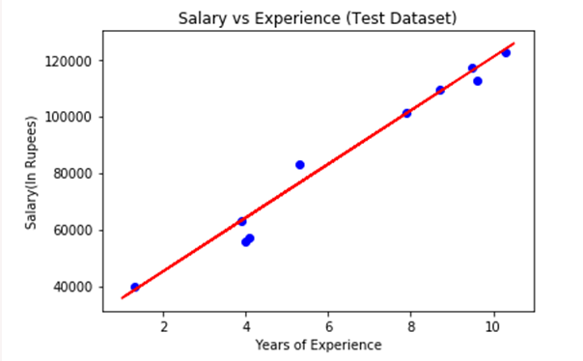
Simple Linear Regression
Example of visual OUTPUT of a Test data set.

Slide 6
Multiple Linear Regression
Relationship two or more independent variables and one dependent variable
Example: How can rainfall, temperature, and amount of fertilizer effect crop growth.
Example: The expected yield of a crop at certain levels of rainfall, temperature, and fertilizer.
Two types of Multiple LR:
Linear – straight line
Non-Linear – not straight line

Slide 7
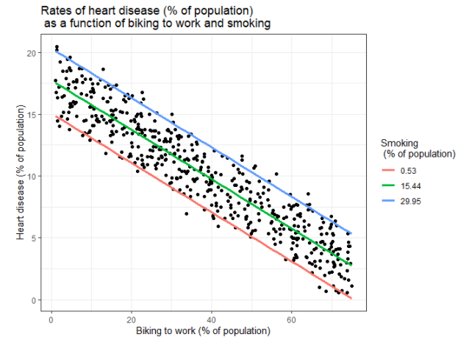
Multiple Linear Regression cont.
Visualizing the results in a graph

Slide 8
CLASSIFICATION
Binary Classifier
Multi-class Classifier
Problem has only two possible outcomes.
e.g., Yes or No, Male or Female
Problem has more than two outcomes.
e.g., Classification of types of crops, classification of types of music.

Slide 9
CLASSIFICATION
Predict the categorical values
Program learns from the given dataset or observations and then classifies new observation into several classes or groups.
E.g., Yes or No, Spam or Not Spam
Classes are called targets/labels or categories.
y=f(x), where y = categorical output

Slide 10
Learners in Classification Problems:
Two types:
Lazy Learners - stores the training dataset and wait until it receives the test dataset
Eager Learners - develop a classification model based on a training dataset before receiving a test dataset
Types of ML Classification Algorithms:
Linear Models
Logistic Regression
Support Vector Machines
Non-linear Models
K-Nearest Neighbours
Kernel SVM
Naïve Bayes
Decision Tree Classification
Random Forest Classification

Slide 11
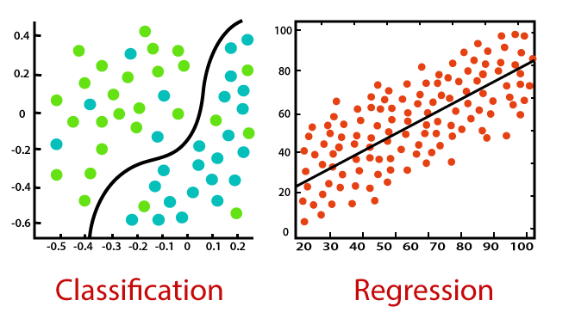
Regression vs. Classification
Predict/Classify the discrete values
Predict the continuous values

